Slide 1
Liverpool Versus Manchester:
Where to Open a German Restaurant

Slide 2
Overview
I. Introduction
II. Data Acquisition
III. Methodology
IV. Results
V. Discussion
VI. Conclusion

Slide 3
Introduction
Problem: Determine the best neighborhood in either Liverpool or Manchester to open a new German restaurant
Background:
Liverpool and Manchester- Two northern cities in England
Liverpool: Capital of Culture in 2008, diverse population, 7th most visited city in the UK
Manchester: Music scene, architecture, 3rd most visited city in the UK
Interests: Analysis is useful for restaurant owners that want to determine the best location to open a new restaurant

Slide 4
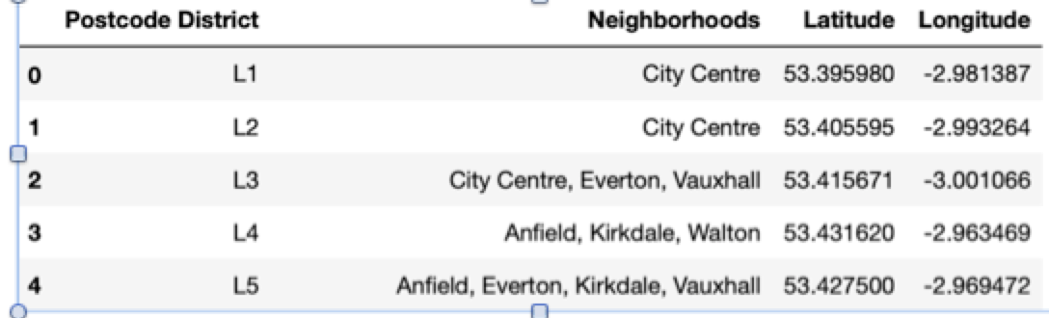
Data Acquistion
Data Sources
BeautifulSoup used to scrape Wikipedia Tables for Manchester and Liverpool neighborhoods
Cleaned Tables:
Liverpool: 40 postcode districts
Manchester: 43 postcode districts
Geocoder used to add Latitude and Longitude to Liverpool and Manchester Neighborhoods
Final Table Example:

Slide 5
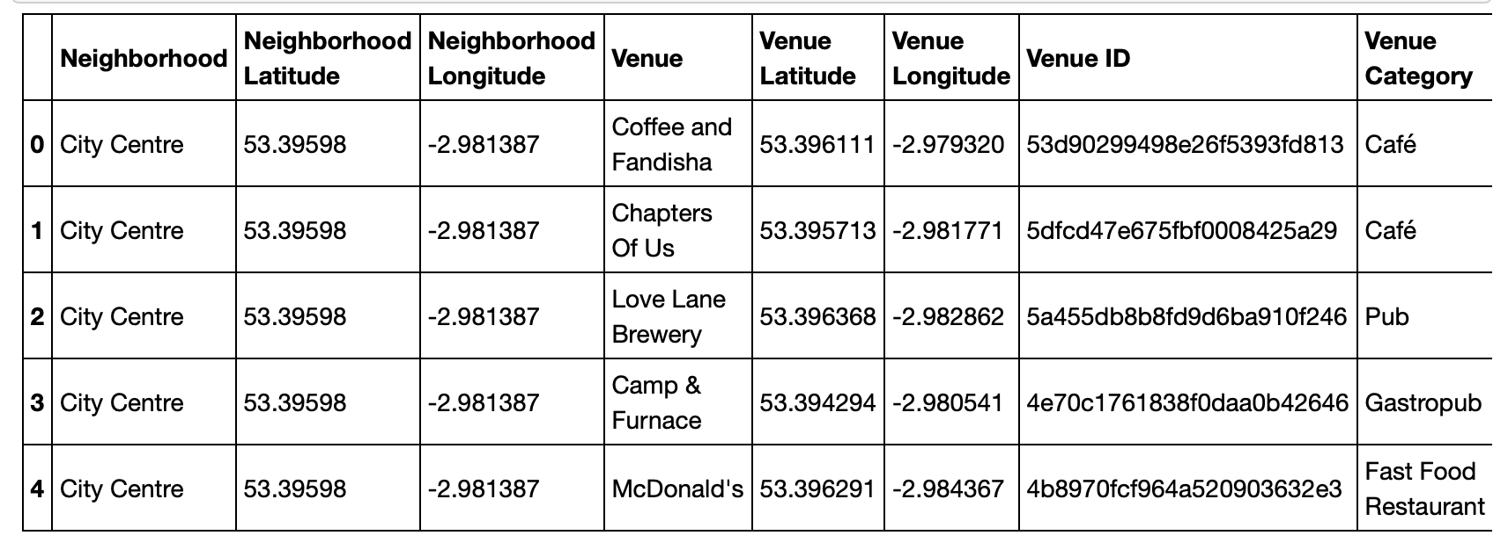
Data Acqusition
Venue data obtained from FourSquare
Table created containing restaurant venues only
Final table example:

Slide 6
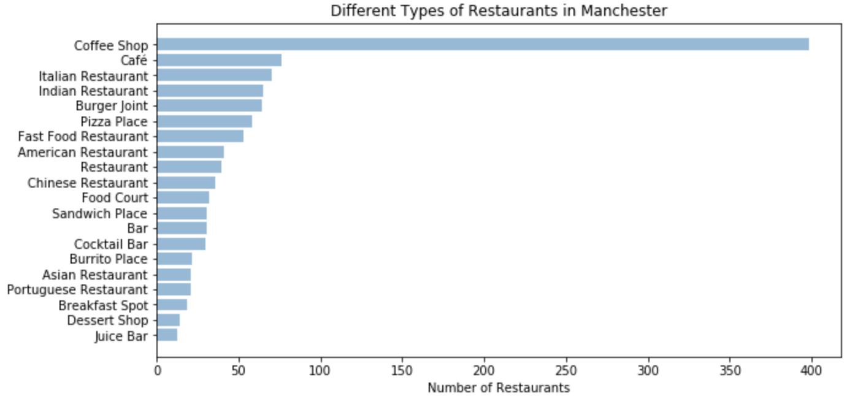
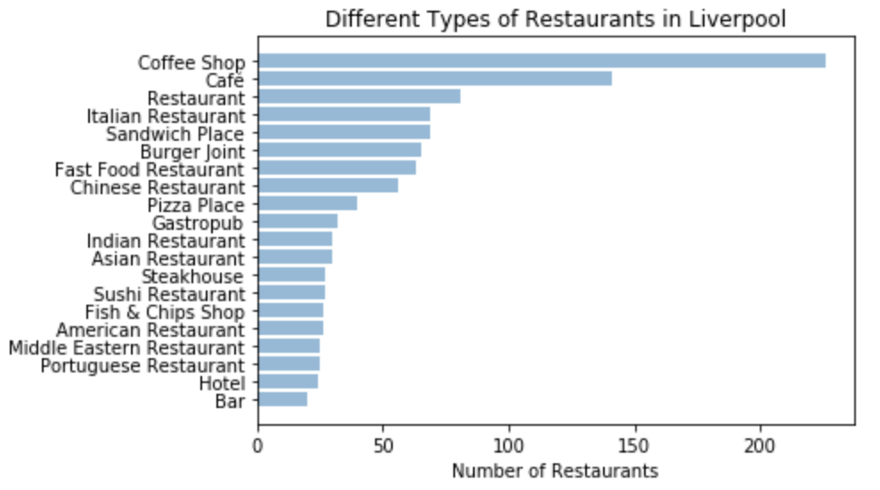
Methodology
Restaurant
Diversity

Slide 7
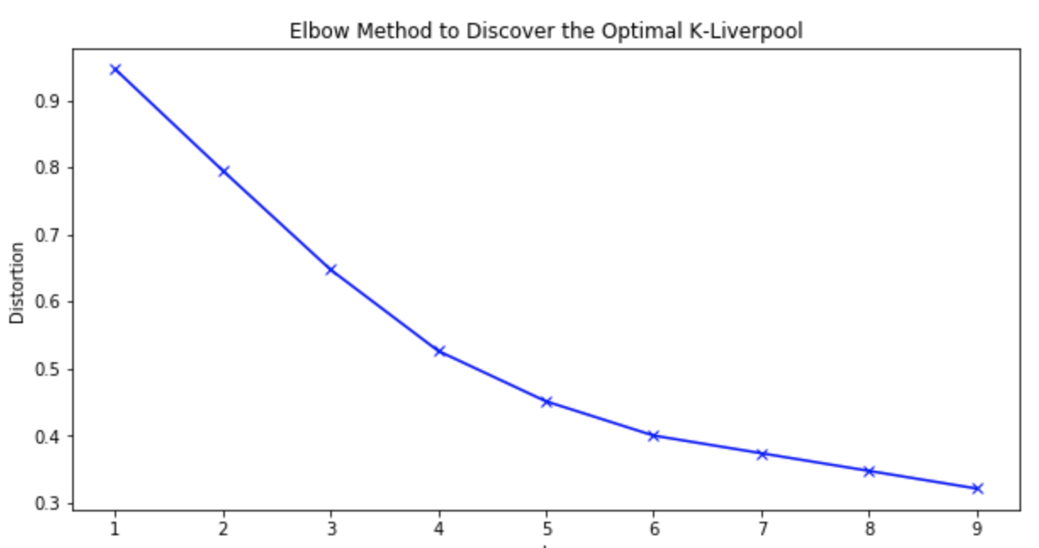
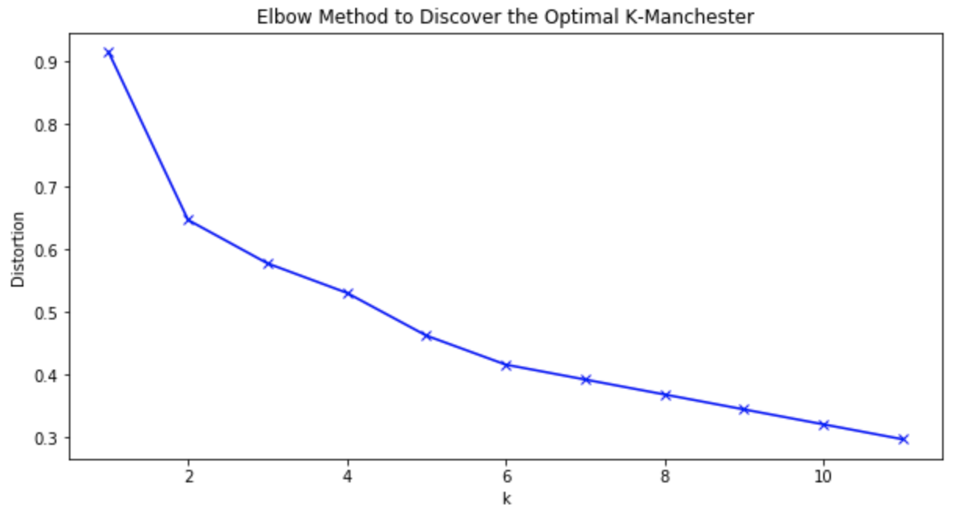
Methodology
Finding K for K-mean Clustering

Slide 8
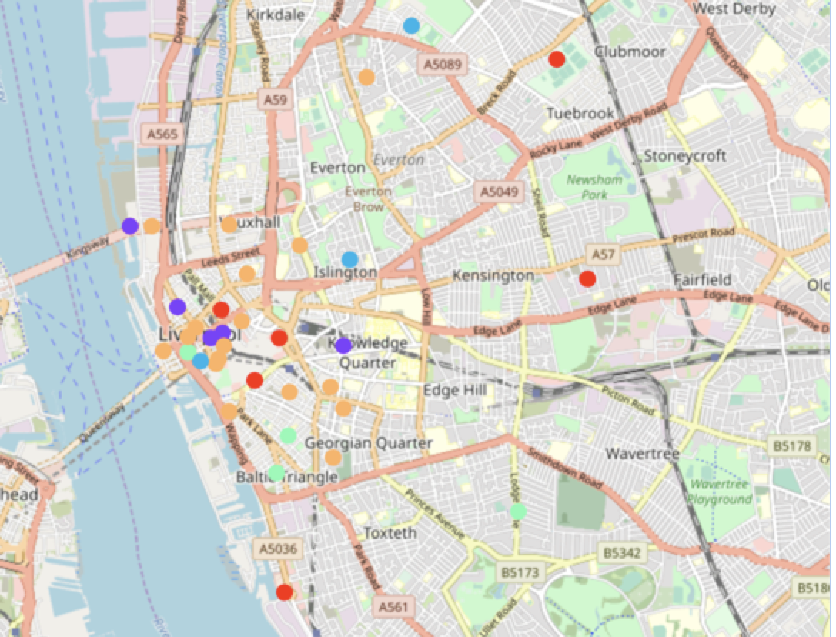
Methodology
Mapping Liverpool Clusters
Neighborhood Clusters
Variety
Coffee Shops
Chinese Restaurants
Restaurants
Cafés

Slide 9
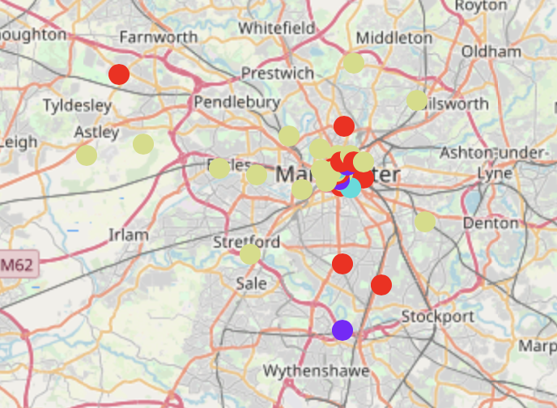
Methodology
Mapping Manchester Clusters
Neighborhood Clusters
Coffee Shops
Chinese Restaurants
Restaurants
Cafés

Slide 10
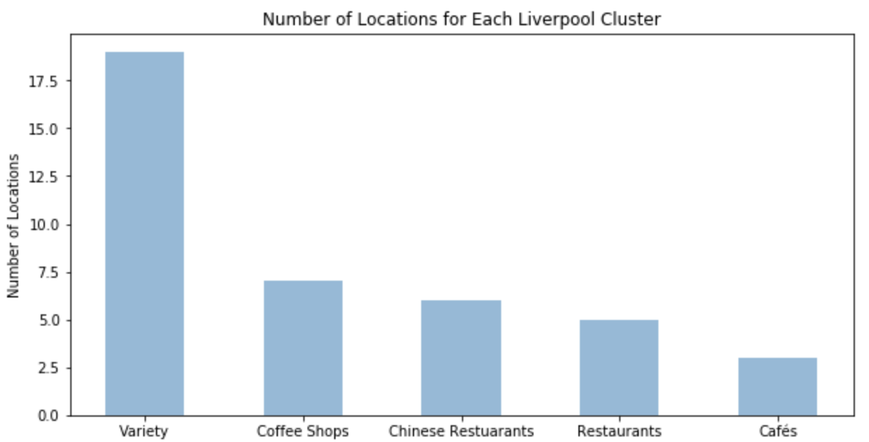
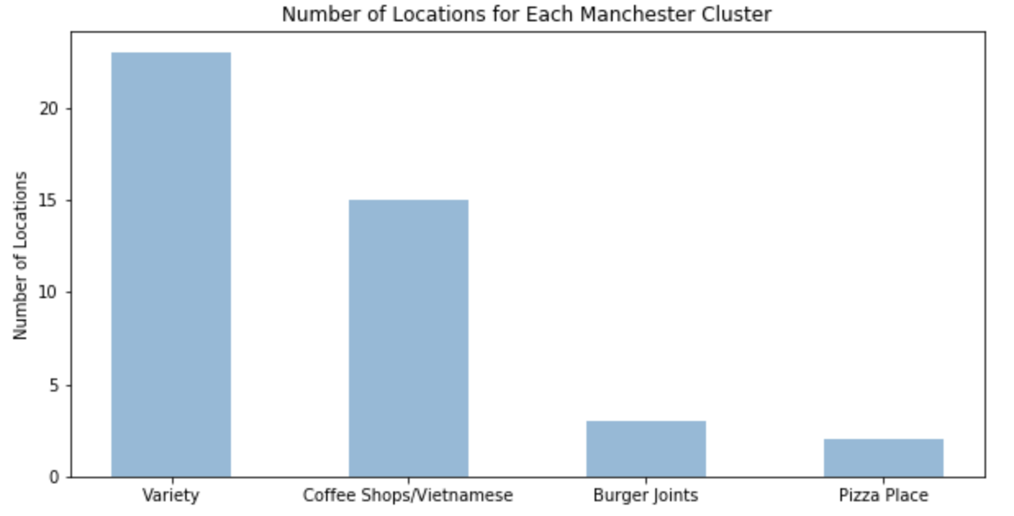
Methodology
Number of Neighborhoods
in Each Cluster

Slide 11
Discussion
Liverpool has more restaurants featuring cuisine from different places around the world
Both cities have a variety cluster featuring majority of restaurants with different cuisine from different parts of the world
Majority of neighborhoods in this cluster are located in downtown area of each city

Slide 12
Conclusion
A cluster zero (Variety) neighborhood in downtown Liverpool would be best location to open a new German restaurant

